Slide 1

Network Reactive
Failure Recovery
Group 10: Failure Recovery
Group Members
Nwanneka Okpala
Kamal Lamey
Saron Tsegay
Tanushree Pandit
s

Slide 2
Group Introduction & Objectives
Project Scope
Our project implements a reactive failure recovery mechanism in a Software-Defined Networking (SDN) environment. We utilize a custom POX controller script to manage network traffic dynamically.
Goal: Achieve seamless recovery without relying on internal controller failure detection.
Key Objectives
Collect external failure notices from network links.
Update flow tables in switches to reroute traffic
Validate recovery by re-generating traffic with iperf.

Slide 3
Simulation Environment
The simulation environment is built using Mininet and consists of:
2 Hosts: H1 (source) and H2 (destination)
4 Switches: S2, S3, S4, S5
The topology provides redundant paths between the hosts.
Primary Path:
H1 → S3 → S2 → S4 → H2
Backup Path:
S3 → S5 → S4
The redundancy allows the controller to reroute traffic when failures occur, demonstrating fault tolerance.

Slide 4
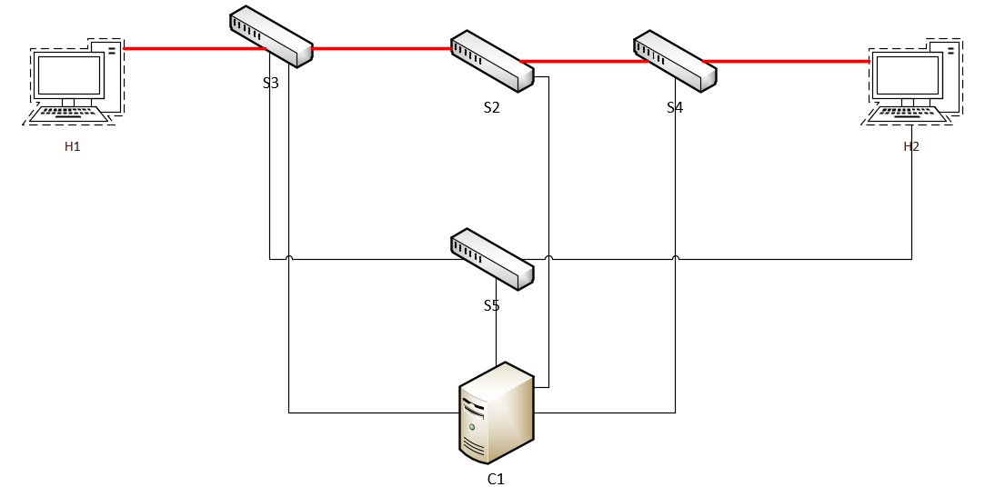
Main Predefined Path
Primary Path:
H1 → S3 → S2 → S4 → H2

Slide 5
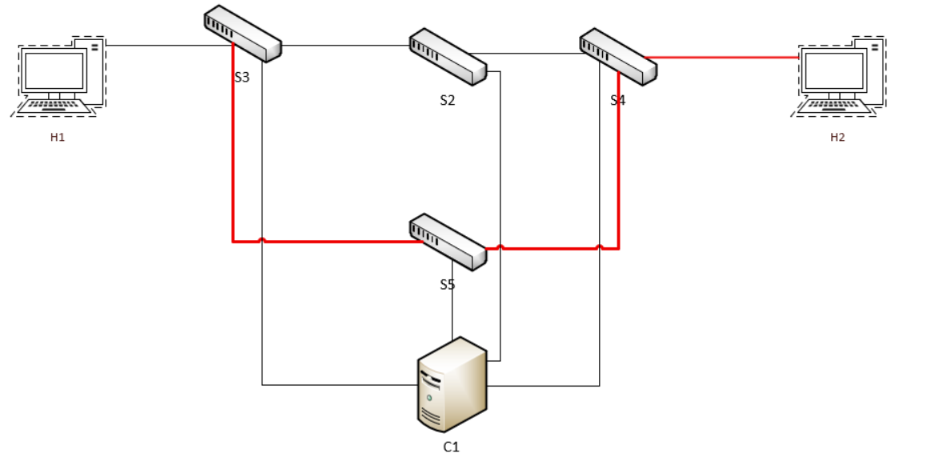
Back-up Path in Event of Failure
Backup Path:
S3 → S5 → S4

Slide 6




Platform & Tools
Mininet
iperf
POX Controller
Open vSwitch
Creates the virtual SDN environment containing hosts and OpenFlow switches
Python-based controller handling OpenFlow Communications
OpenFlow enabled virtual switches used to build and emulate the topology.
Generates TCP/UDP traffic to
validate throughput recover

Slide 7
High-Level System Design
Controller Logic
Topology Manager: Discovers switch connections and port mappings.
Failure Detector: Listens for PortStatus events to identify link failures (e.g., S3-S2).
Recovery Modules
Path Selector: Decides to switch from the primary to the backup path upon failure notification.
Flow Manager: Installs new OpenFlow rules on S2 and H2 to redirect traffic immediately.

Slide 8
Methodology: The “OperationSaveTheDay" Script
Inspect Traffic: trafficSniffer() monitors flows.
Check Failure: failChecker() looks for dropped link
Record Data: failureTag() logs timestamp and link ID
Re-compute: computePath() finds alternative route.
Update: updateFlowTables() pushes new rules.
Validate: generateNetTraffic() runs iperf checks

Slide 9
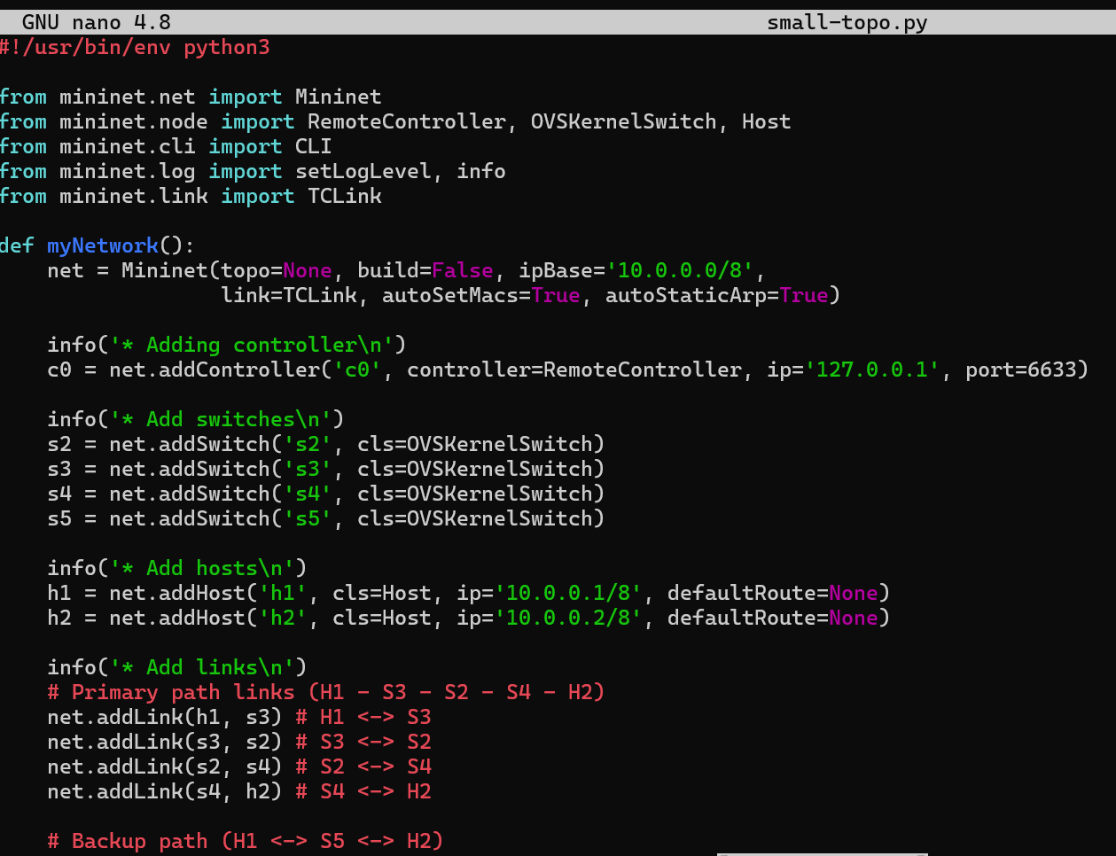
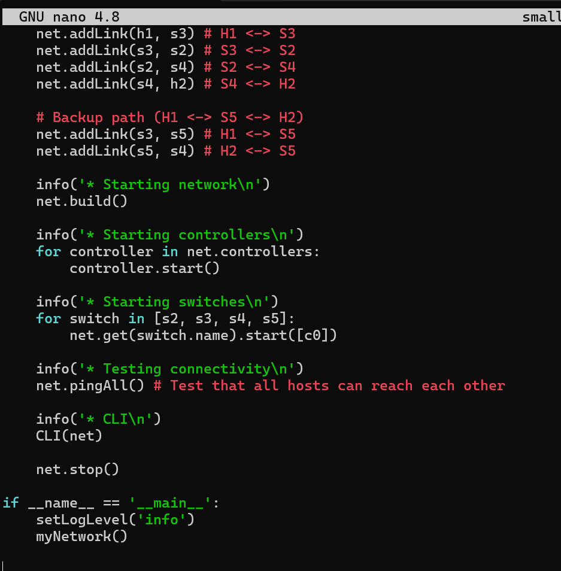
Topology Implementation
This is the code for mininet topology (small-topo.py.
It builds a small test network with two hosts (h1 and h2) and four switches ( s2, s3,s4,s5) while a backup path goes through s3->s5>54.
This set up lets us test the controller failover logic by stimulating link failures and watching traffic reroutes automatically.

Slide 10
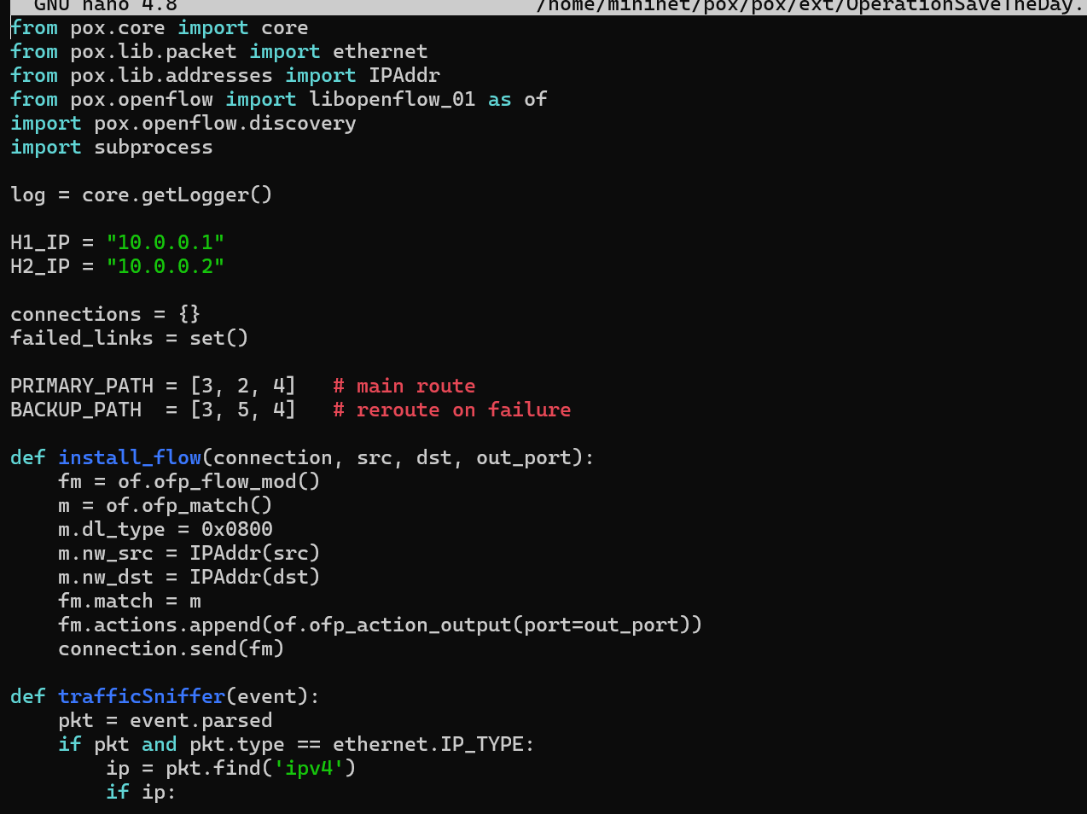
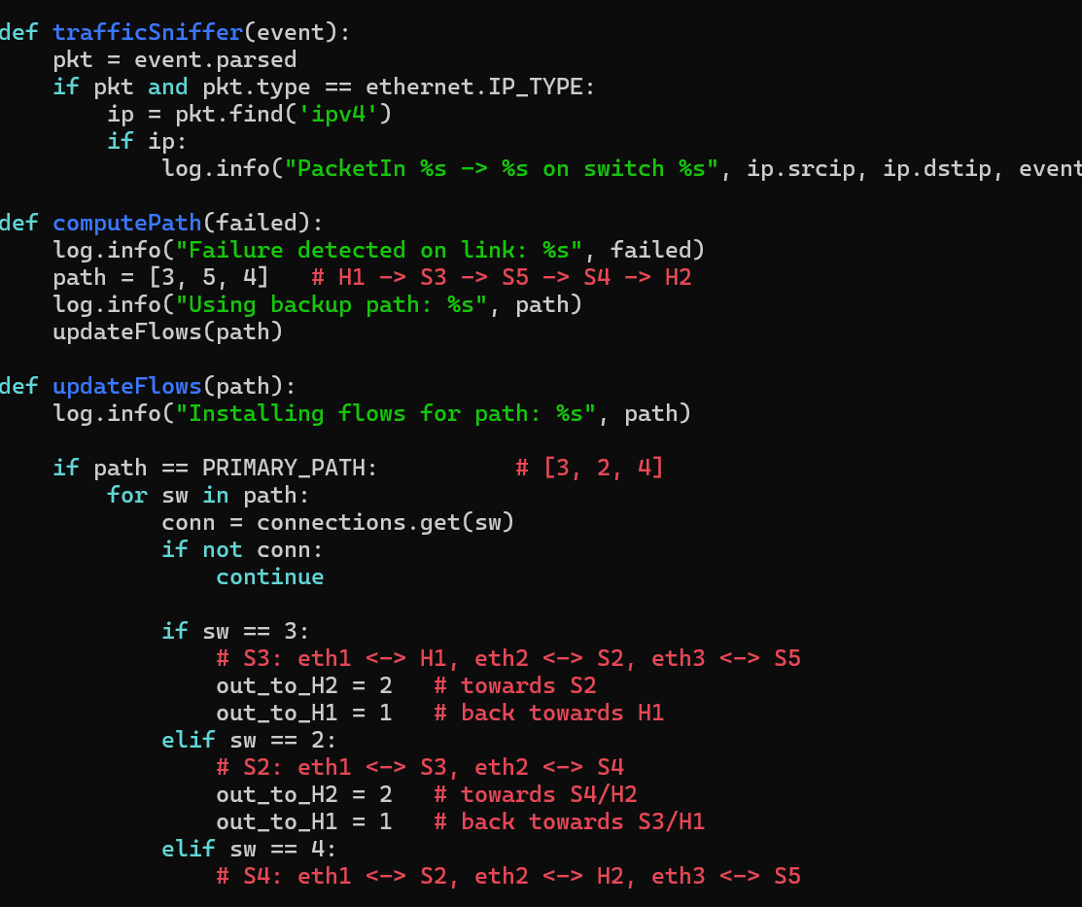
OperationSaveTheDay.py Implementation
In this project, we built a custom POX control called OperationSaveTheDay.py to keep two hosts(h1 and h2) connected.
It uses a primary path through switch s3-s2-s4.

Slide 11
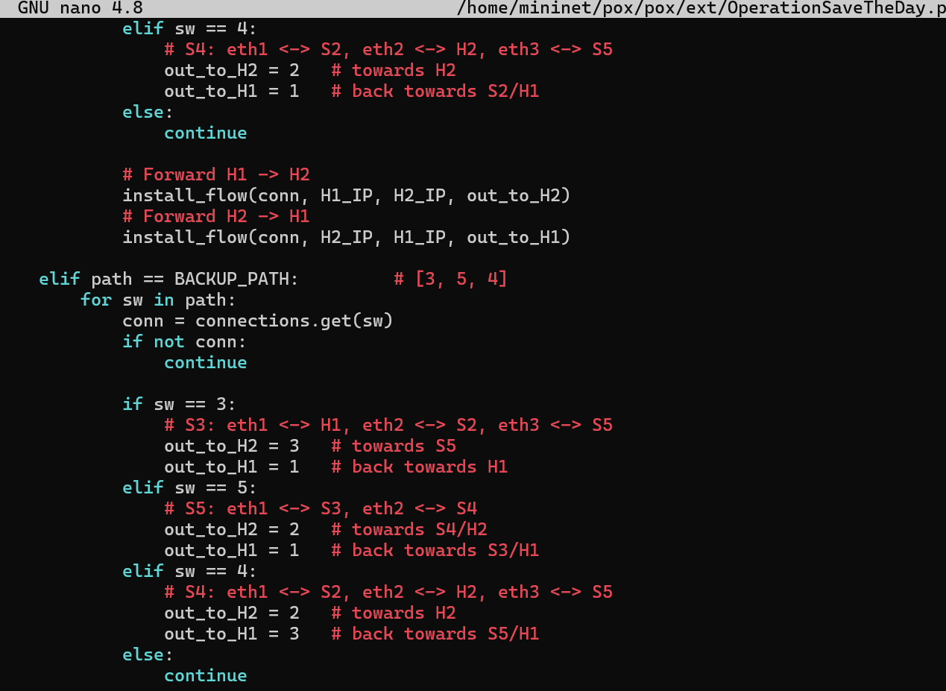
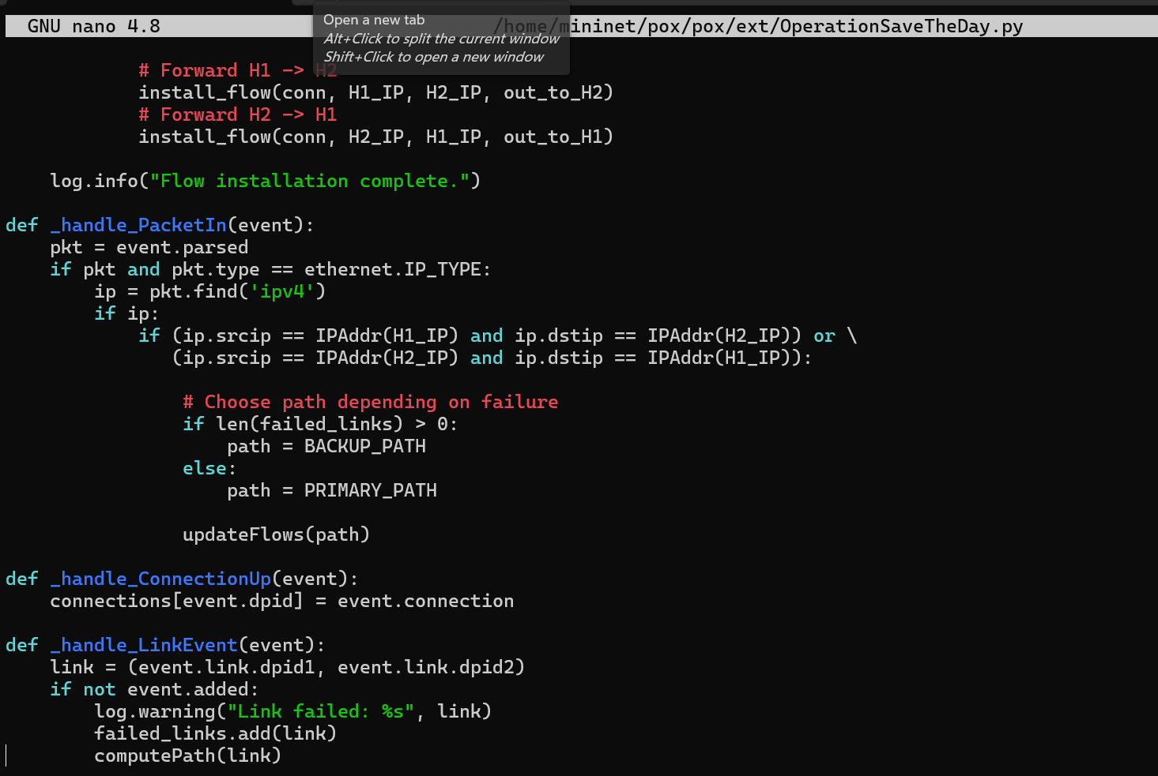
OperationSaveTheDay.py Implementation cont’d
If the primary link fails, it reroutes through 3-5-4.

Slide 12
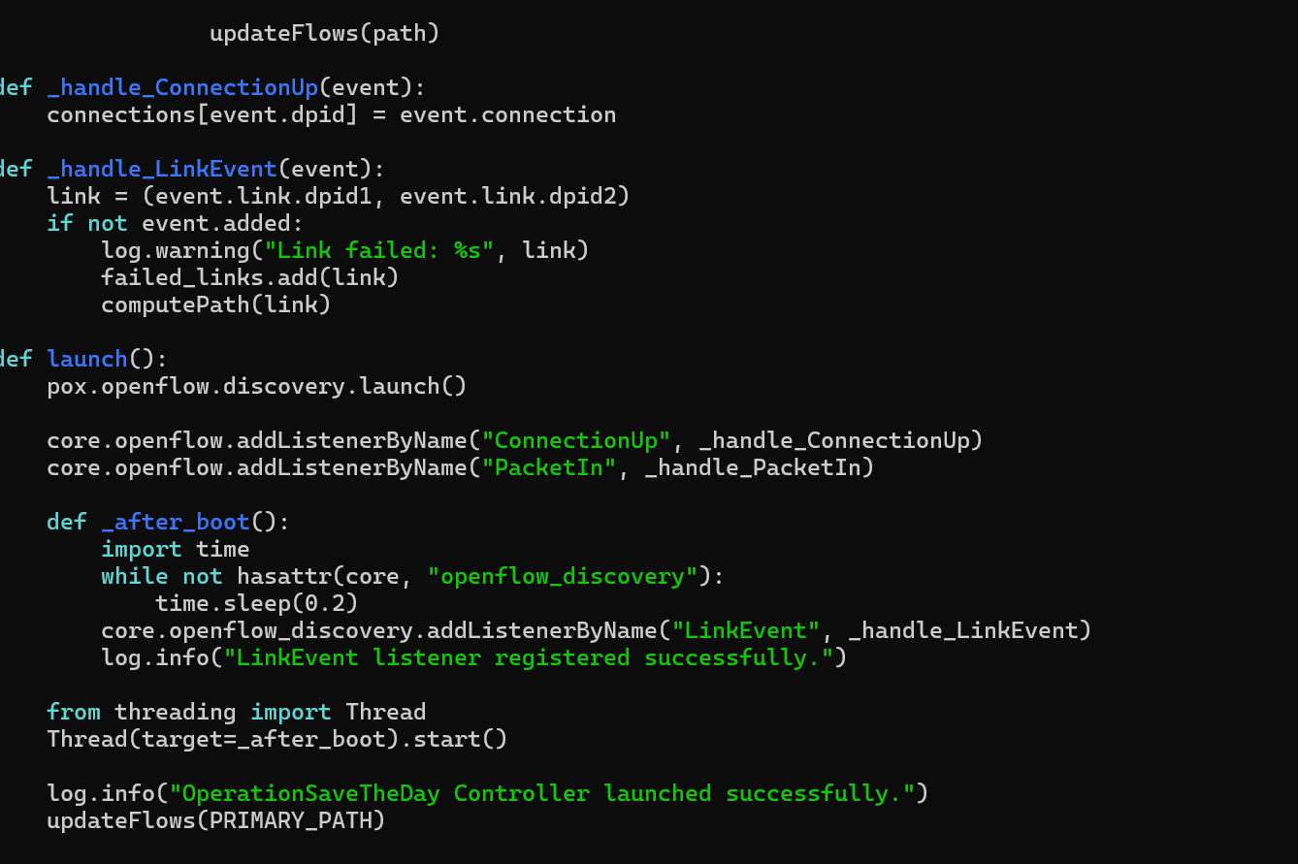
OperationSaveTheDay.py Implementation cont’d
The code listens POXs discovery events, updates its adjacency map, and reprograms the switches automatically. That way , connectivity is maintained even during failures.

Slide 13

Showcase Demo
Simulation Workflow
1. Launch POX Controller.
2. Start Mininet Topology.
3. Run iperf traffic from H1 to H2 to measure baseline throughput.
4. Simulate Failure:
mininet> link s3 s2 down
5. Observe real-time recovery logs.

Slide 14
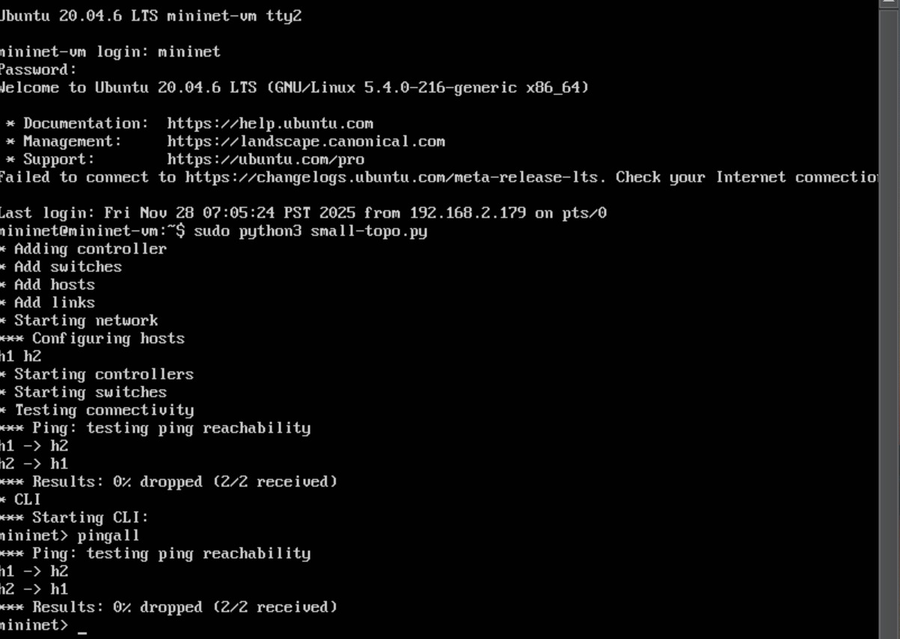
Execute Topology and Test Connectivity

Slide 15
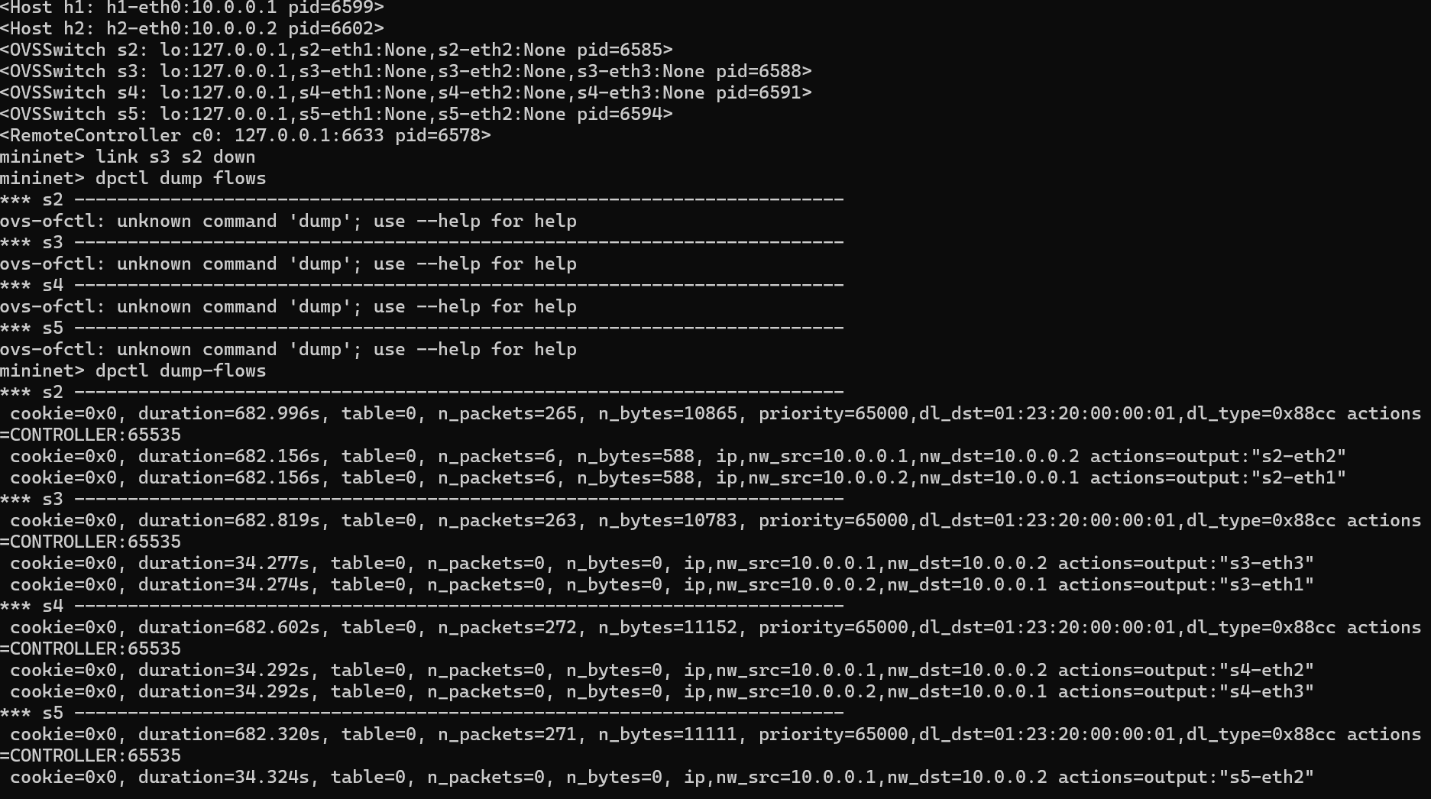
Failure Scenario Topology
Command to drop s2
Flows after failing s2

Slide 16
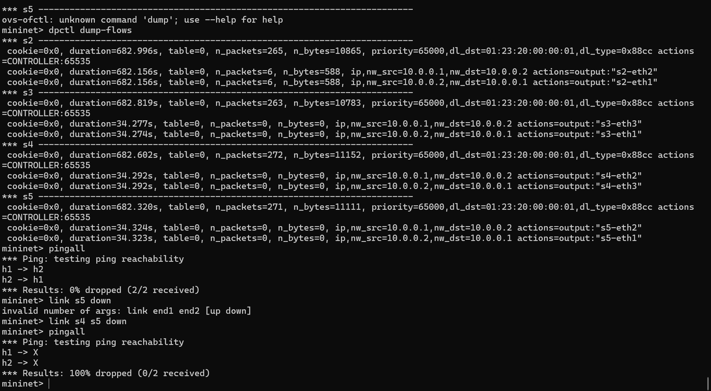
Recovery Failure Scenario (traffic going through backup route)

Slide 17

THANK YOU FOR LISTENING

